Slide 1


Damon H
Dec 10, 2022

Slide 2

Outline
Executive Summary
Introduction
Methodology
Results
Conclusion
Appendix

Slide 3
Executive Summary
Summary of methodologies
Data gathering from public SpaceX API and Wiki pages
Explored data with visualization techniques including dashboard generation and folium maps
Classified successful landings
Standardize data for best parameters for machine learning models
Summary of all results
Generated four machine learning models with an approximate accuracy of 83%
Logistic Regression
Support Vector
Decision Tree
K-Nearest Neighbors

Slide 4

Introduction
Project background and context
The commercial space age is here, companies are making space travel affordable for everyone and perhaps the most successful is SpaceX.
One reason for SpaceX’s success is their rocket launches are relatively inexpensive. SpaceX advertises Falcon9 rocket launches at a cost of $62 million where others cost upwards of $165 million and much of the savings is because SpaceX can reuse the first stage with a successful landing.
Therefore, if we can determine whether the first stage will land, we can determine the cost of a launch.
Problem
Space Y would like to compete with SpaceX and our role is to determine the price of each launch.

Slide 5

Section 1

Slide 6
Methodology
Data collection methodology:
Data was gathered from the SpaceX REST API with data about launches, including information about the rocket used, payload delivered, launch specifications, landing specifications, and landing outcome.
Perform data wrangling
Performed Exploratory Data Analysis (EDA) to find patterns and determine the labels for training supervised models.
Perform exploratory data analysis (EDA) using visualization and SQL
Perform interactive visual analytics using Folium and Plotly Dash
Perform predictive analysis using classification models
Preprocessed to standardize the data and split it into training and testing data. Trained the model and performed Grid Search, yielding the hyperparameters for best performance. Determined the model with the best accuracy using the training data. Tested with Logistic Regression, Support Vector machines, Decision Tree Classifier, and K-nearest neighbors and output the confusion matrix

Slide 7
Data Collection – SpaceX API
Call APIs and create lists using rocket, launchpads, payloads, and cores columns
Using the IDs, applied functions to complete data set including booster name, payload mass, launch site and location, etc.
Import Libraries & Define Auxiliary Functions
Used .json_normalize() to convert into a Pandas dataframe
Combine columns into dictionary and create Pandas dataframe
Filter on Falcon9 launches and create new dataframe
Reset Flight Number column after removing rows that weren’t Falcon9
Github link to Coursera-Applied-Data-Science-Capstone Data Collection API Notebook

Slide 8
Data Wrangling
Use value_counts() on LaunchSite column for number of launches from each site
Use value_counts() on Orbit column for number of each orbit
Use value_counts() on Outcome column for number of each outcome
Load csv from Scraping section
Create set of outcomes where second stage failed landing
Classify landing outcomes where 1 is successful and 0 is failure
Export to csv format
Github link to Coursera-Applied-Data-Science-Capstone Data Wrangling Notebook

Slide 9
EDA with SQL
Displayed the following...
Unique landing outcomes
Unique launch sites
5 records where launch sites begin with the string ‘CCA’
Total payload mass carried by boosters launched by NASA (CRS)
Average payload mass carried by booster version F9 v1.1
Date of first successful landing outcome was achieved
Names of the boosters which have success in drone ships and payload masses greater than 4,000kg, but less than 6,000kg
Total number of successful and failed mission outcomes
Booster versions which have carried maximum payload mass
Names of the months, failed landings on drone ships, their booster versions, and lanuch sites for 2015
Count of successful landings between June 4, 2010, and March 20, 2017, in descending order
Github link to Coursera-Applied-Data-Science-Capstone EDA with SQL Notebook

Slide 10
EDA with Data Visualization
Plots used include the following
Flight Number vs. Payload Mass
Flight Number vs. Launch Site
Payload Mass vs. Launch Site
Orbit vs. Success Rate
Flight Number vs. Orbit
Success Yearly Trend
Scatter plots, line charts, and bar plots used to compare relationships between variables to determine whether a relationship existed tin order to enable training the machine learning model
Github link to Coursera-Applied-Data-Science-Capstone EDA with Visualization Notebook

Slide 11
Build an Interactive Map with Folium
Folium maps marked Launch Sites, successful and unsuccessful landings, and proximity key locations: Railway, Highway, Coast, and City
Folium maps help gain understanding on why launch sites may be located where they are and provides visualization of successful landings relative to location
Github link to Coursera-Applied-Data-Science-Capstone Interactive Visual Analytics with Folium Notebook

Slide 12
Build a Dashboard with Plotly Dash
Dashboard includes pie chart and scatter plot
Pie chart shows distribution of successful landings across launch sites and individual launch site success rates
Scatter plot shows variance of successes across launch sites, payload masses, and booster versions
Github link to Coursera-Applied-Data-Science-Capstone Dashboard Application with Plotly Dash Notebook

Slide 13
Predictive Analysis (Classification)
Create NumPy array from Class category
Standardize the data and transform to new DataFrame
Using train_test_split, split data into training and test data
Create logistic regression object to find best parameters from dictionary
Output GridSearchCV object for logistic regression
Display bets parameters using data attribute Best_Params_
Display accuracy n validation data using data attribute Best_Score_
Calculate accuracy on test data using Score method
Use Confusion Matrix to determine issues
Create support vector machine object to find best parameters
Calculate accuracy on test data using Score method
Plot new Confusion Matrix

Slide 14
Predictive Analysis (Classification) – continued…
Create Decision Tree Classifier Object
Fit Object into best parameters from dictionary
Calculate accuracy of Tree on test data using Score method
Plot new Confusion Matrix
Create k Nearest Neighbor object
Fit Object into best parameters from dictionary
Calculate accuracy of Tree on test data using Score method
Plot new Confusion Matrix
Find best method from logistic regression, support vector machine, decision tree classifier, and k nearest neighbors
Github link to Coursera-Applied-Data-Science-Capstone Machine Learning Predictions Lab Notebook

Slide 15
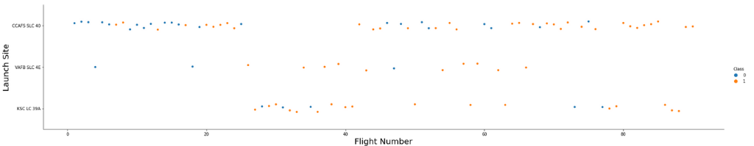
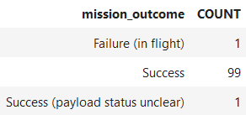
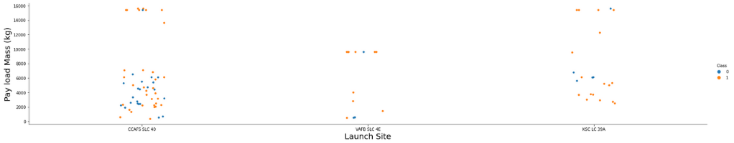
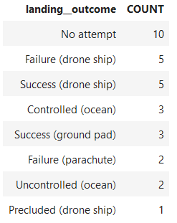
Results
Exploratory data analysis results with SQL
Total number of successful and failed mission outcomes
Landing outcomes between June 4, 2010, and March 20, 2017
Exploratory data analysis visualization results
Flight Number vs. Launch Site
Payload vs. Launch Site

Slide 16
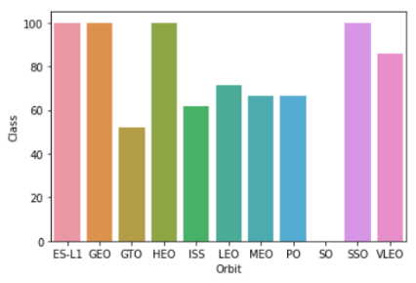
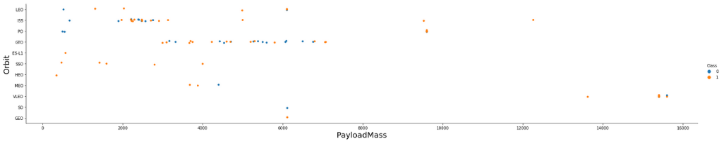
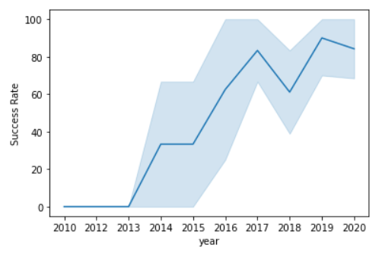
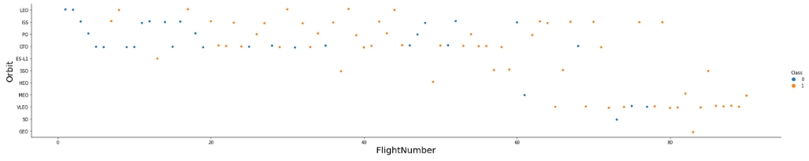
Results
Exploratory data analysis visualization results
Orbit by Class
Flight Number vs. Orbit
Exploratory data analysis visualization results
Payload Mass vs. Orbit
Yearly Trend

Slide 17
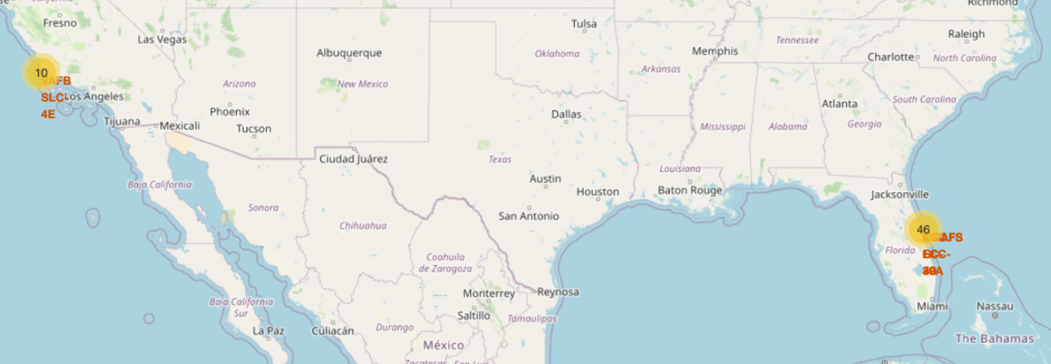
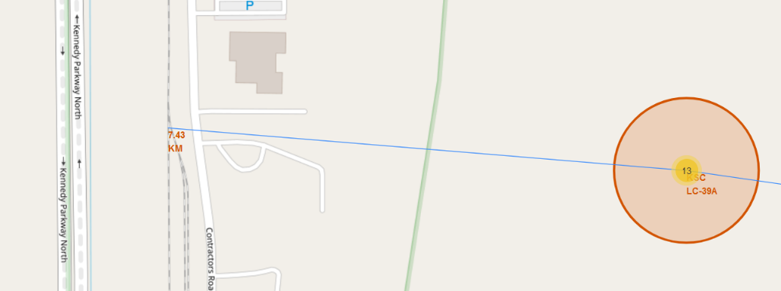
Results
Interactive analytics demo in screenshots
Orbit by Class
Flight Number vs. Orbit
Exploratory data analysis visualization results
Payload Mass vs. Orbit
Yearly Trend

Slide 18
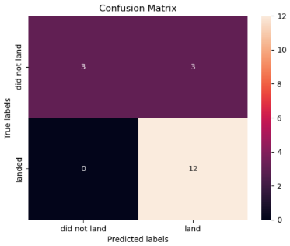
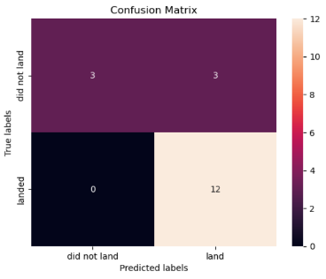
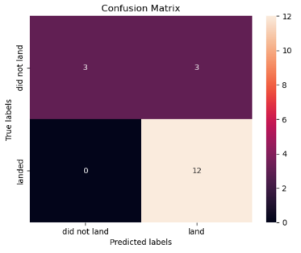
Results
Predictive Analysis Results
Accuracy of Logistical Regression: 83.3%
Accuracy of Support Vector Machine: 83.3%
Best Method: Decision Tree Classifier
Accuracy of Decision Tree Classifier: 94.4%
Accuracy of K-Nearest Neighbors: 83.3%

Slide 19

Section 2

Slide 20

Flight Number vs. Launch Site
Show a scatter plot of Flight Number vs. Launch Site
Most Launch Sites were CCAFS SLC-40
There are streaks where a specific launch site was used often
Initially, it was CCAFS SLC-40, then KSC LC 39A, and then more at CCAFS SLC-40
There appears to be more failed missions in the earlier flights than later as well

Slide 21
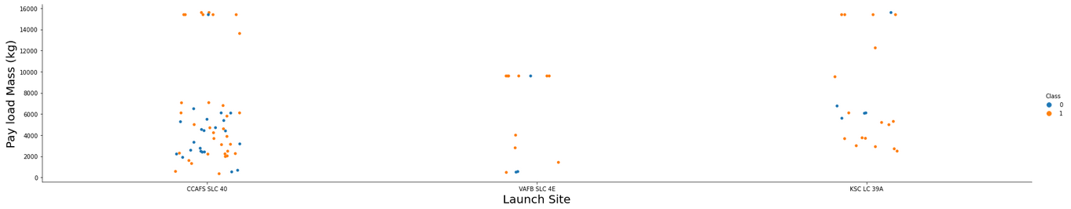
Payload vs. Launch Site
Show a scatter plot of Payload vs. Launch Site
There are no launches from VAFB SLC-4E with payloads larger than 10,000kg
VAFB SLC-4E has the bulk of the launches with payloads of 10,000kg
Higher success rates with the higher payloads as well
CCAFS SLC-40 has the most launches

Slide 22

Success Rate vs. Orbit Type
ES-L1, GEO, HEO, and SSO have the highest success rates
GTO has the lowest success rate
No launches to orbit SO

Slide 23
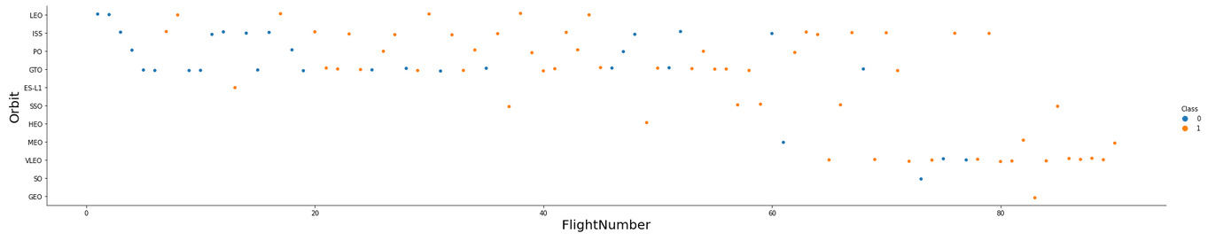
Flight Number vs. Orbit Type
Show a scatter point of Flight number vs. Orbit type
LEO Orbit had success after 2 flights
GTO also increased in success overtime, but to a much less degree

Slide 24
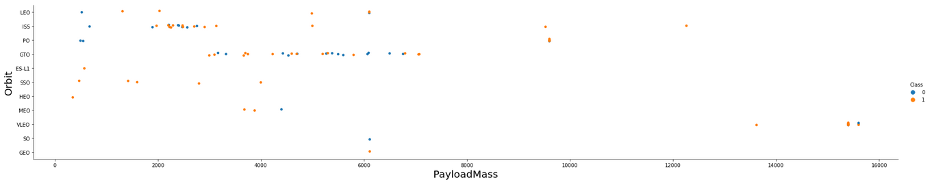
Payload vs. Orbit Type
Show a scatter point of payload vs. orbit type
ISS had total success with higher payloads
GTO is undistinguishable for success and fails relative to payload mass
SSO only had success, but none with larger than 4,000kg payloads

Slide 25
Launch Success Yearly Trend
Success rate dramatically increased from 2013 to 2017
From 2017 to 2020, however, success rate only increased slightly

Slide 26
All Launch Site Names
Unique Launch Sites
Launch Site
CCAFS LC-40
CCAFS SLC-40
KSC LC-39A
VAFB SLC-4E

Slide 27
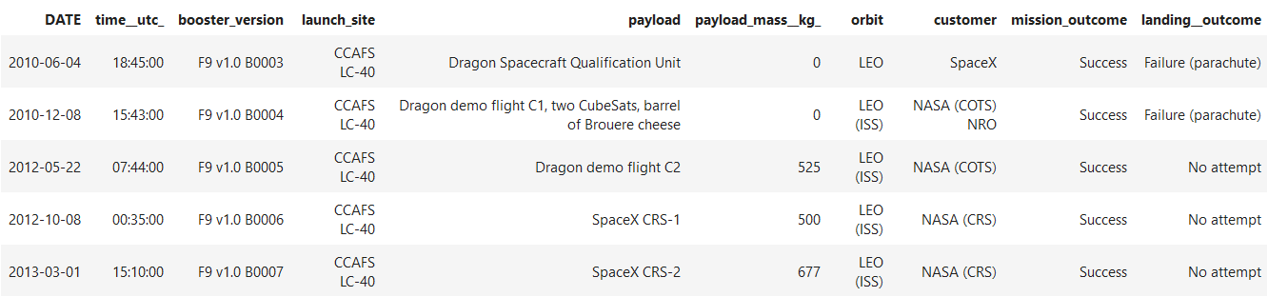
Launch Site Names Begin with 'CCA'
Five records where launch sites begin with `CCA`

Slide 28
Total Payload Mass
Total payload carried by boosters from NASA
45,596kg
%sql select sum(payload_mass__kg_) as sum from SPACEX where customer like 'NASA (CRS)'

Slide 29
Average Payload Mass by F9 v1.1
Average payload mass carried by booster version F9 v1.1
2,534kg
%sql select avg(payload_mass_kg_) as Average from SPACEX where booster_version like 'F9 v1.1%'

Slide 30
First Successful Ground Landing Date
Date of the first successful landing outcome on ground pad
June 4, 2010
%sql select min(date) as Date from SPACEX where mission_outcome like 'Success'

Slide 31
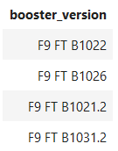
Successful Drone Ship Landing with Payload between 4000 and 6000
Names of boosters which have…
successfully landed
on drone ship and
had payload mass greater than 4000
but less than 6000
%sql select booster_version from SPACEX where (mission_outcome like 'Success') AND (payload_mass_kg_ BETWEEN 4000 AND 6000) AND (landing_outcome like 'Success (drone ship)')

Slide 32
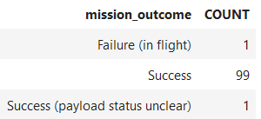
Total Number of Successful and Failure Mission Outcomes
Total number of successful and failure mission outcomes
%sql SELECT mission_outcome, count(*) as Count FROM SPACEX GROUP by mission_outcome ORDER BY mission_outcome

Slide 33
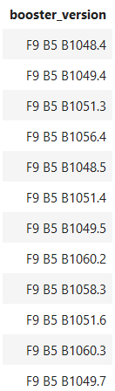
Boosters Carried Maximum Payload
Names of the booster versions which have carried the maximum payload mass
%sql select booster_version from SPACEX where payload_mass__kg_=(select max(payload_mass__kg_) from SPACEX)

Slide 34
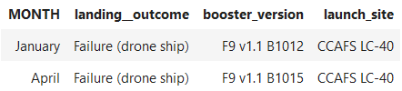
2015 Launch Records
Failed landing outcomes in drone ship, their booster versions, and launch site names in 2015
%sql select MONTHNAME(DATE) as Month, landing_outcome, booster_version, launch_site from SPACEX where DATE like '2015%' AND landing_outcome like 'Failure (drone ship)'

Slide 35
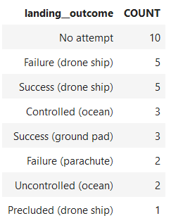
Rank Landing Outcomes Between 2010-06-04 and 2017-03-20
Landing outcomes between June 4, 2010, and March 20, 2017, ranked in descending order
%sql select landing_outcome, count(*) as count from SPACEX where Date >= '2010-06-04' AND Date <= '2017-03-20' GROUP by landing_outcome ORDER BY count Desc

Slide 36

Section 3

Slide 37
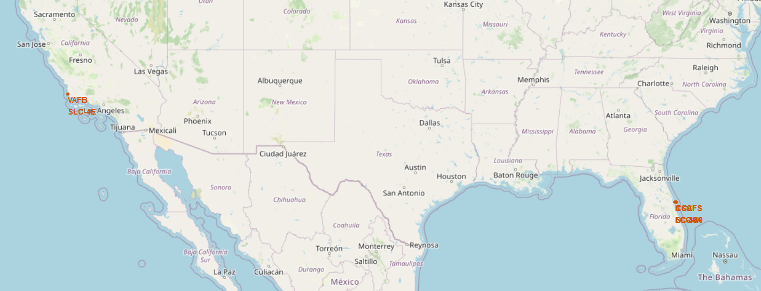
Launch Site Location Markers
All Launch Sites are near a coastline

Slide 38
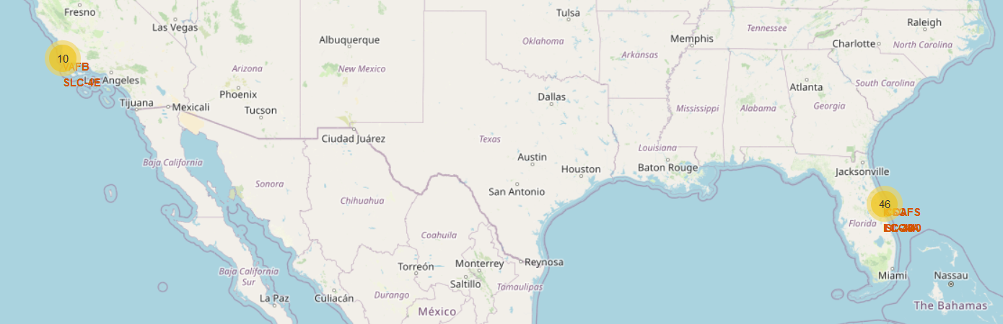
Folium Markers to Marker Cluster for each Launch

Slide 39
Launch Site to Nearest Railway
Distance between
KSC LC-39A and
Nearest Railway
7.43km

Slide 40

Section 4

Slide 41
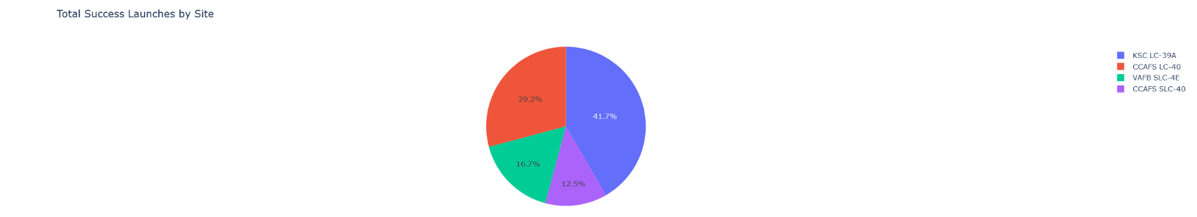
Total Successful Launches by Launch Site
Replace <Dashboard screenshot 1> title with an appropriate title
Show the screenshot of launch success count for all sites, in a piechart
KSC LC-39A has the most successful launches
While CCAFS SLC-40 has the least

Slide 42
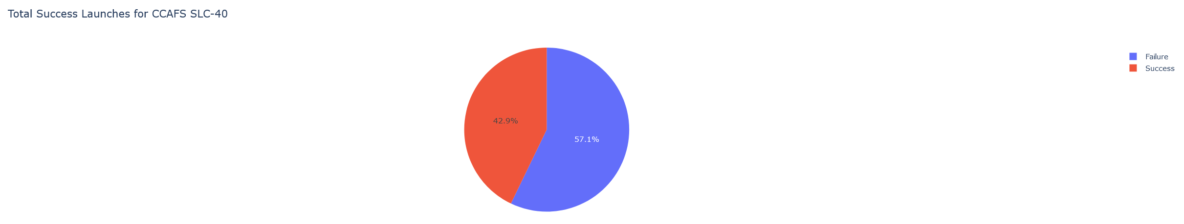
Total Successful Launches for CCAFS SLC-40

Slide 43
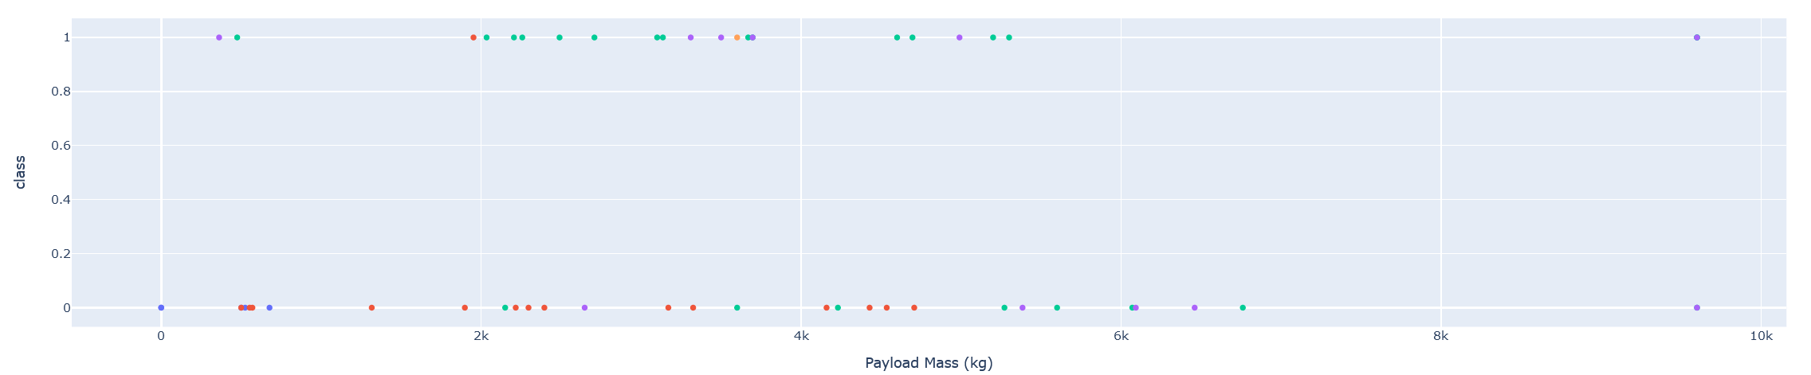
Payload Mass vs. Launch Outcome

Slide 44

Section 5

Slide 45
Classification Accuracy
Bar Chart for model accuracy of all built classification models
Decision Tree Classifier has the highest accuracy

Slide 46
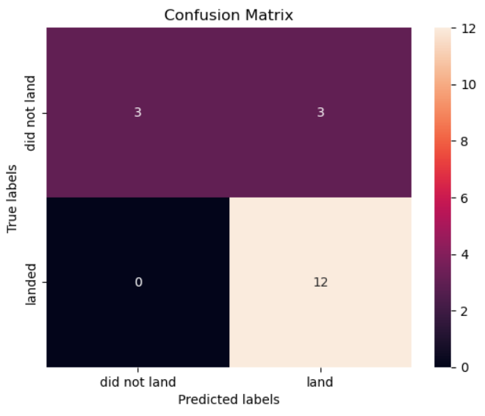
Confusion Matrix
Show the confusion matrix of the Decision Tree Classifier
12 True Negatives and 3 True Positives
Vs.
0 False Negatives and 3 False Positives

Slide 47


